Slide 1
COVID-Xpert: An AI Powered Population Screening of COVID-19 Cases using Chest Radiography Images
https://arxiv.org/abs/2004.03042
Xin Li and Dongxiao Zhu
Machine Learning and Predictive Analytics (MLPA) Lab @ Wayne State University, Computer Science Department
https://dongxiaozhu.github.io/

Slide 2
Background and Motivation
The total COVID-19 tests topped 1.4 million (as of early April) and many more millions are urgently needed
Gold standard RT-PCR has high accuracy but slow turnover and expensive
Computed Tomography (CT) is a promising alternative for hospitals and emergency departments (EDs)
Expensive equipment, dependent on trained radiologists and mixed results exist
Chest Radiography Images and AI powered screening emerge as a potential population screening approach for mobile/urgent/primary care settings

Slide 3
Chest Radiography Image Data Sets
Pre-training Dataset (108,948 non-COVID lung disease images)
ChestX-ray8: Hospital-scale Chest X-ray Database and Benchmarks on Weakly-Supervised Classification and Localization of Common Thorax Diseases.
Fine-Tuning Dataset
COVID-19 Image Data Collection. (185 COVID positive images)
RSNA Pneumonia Detection Challenge. (185 Pneumonia + 185 normal chest X-ray images)
Compiled dataset is split into training/validation/testing sets with 120/20/45 images for each class.

Slide 4
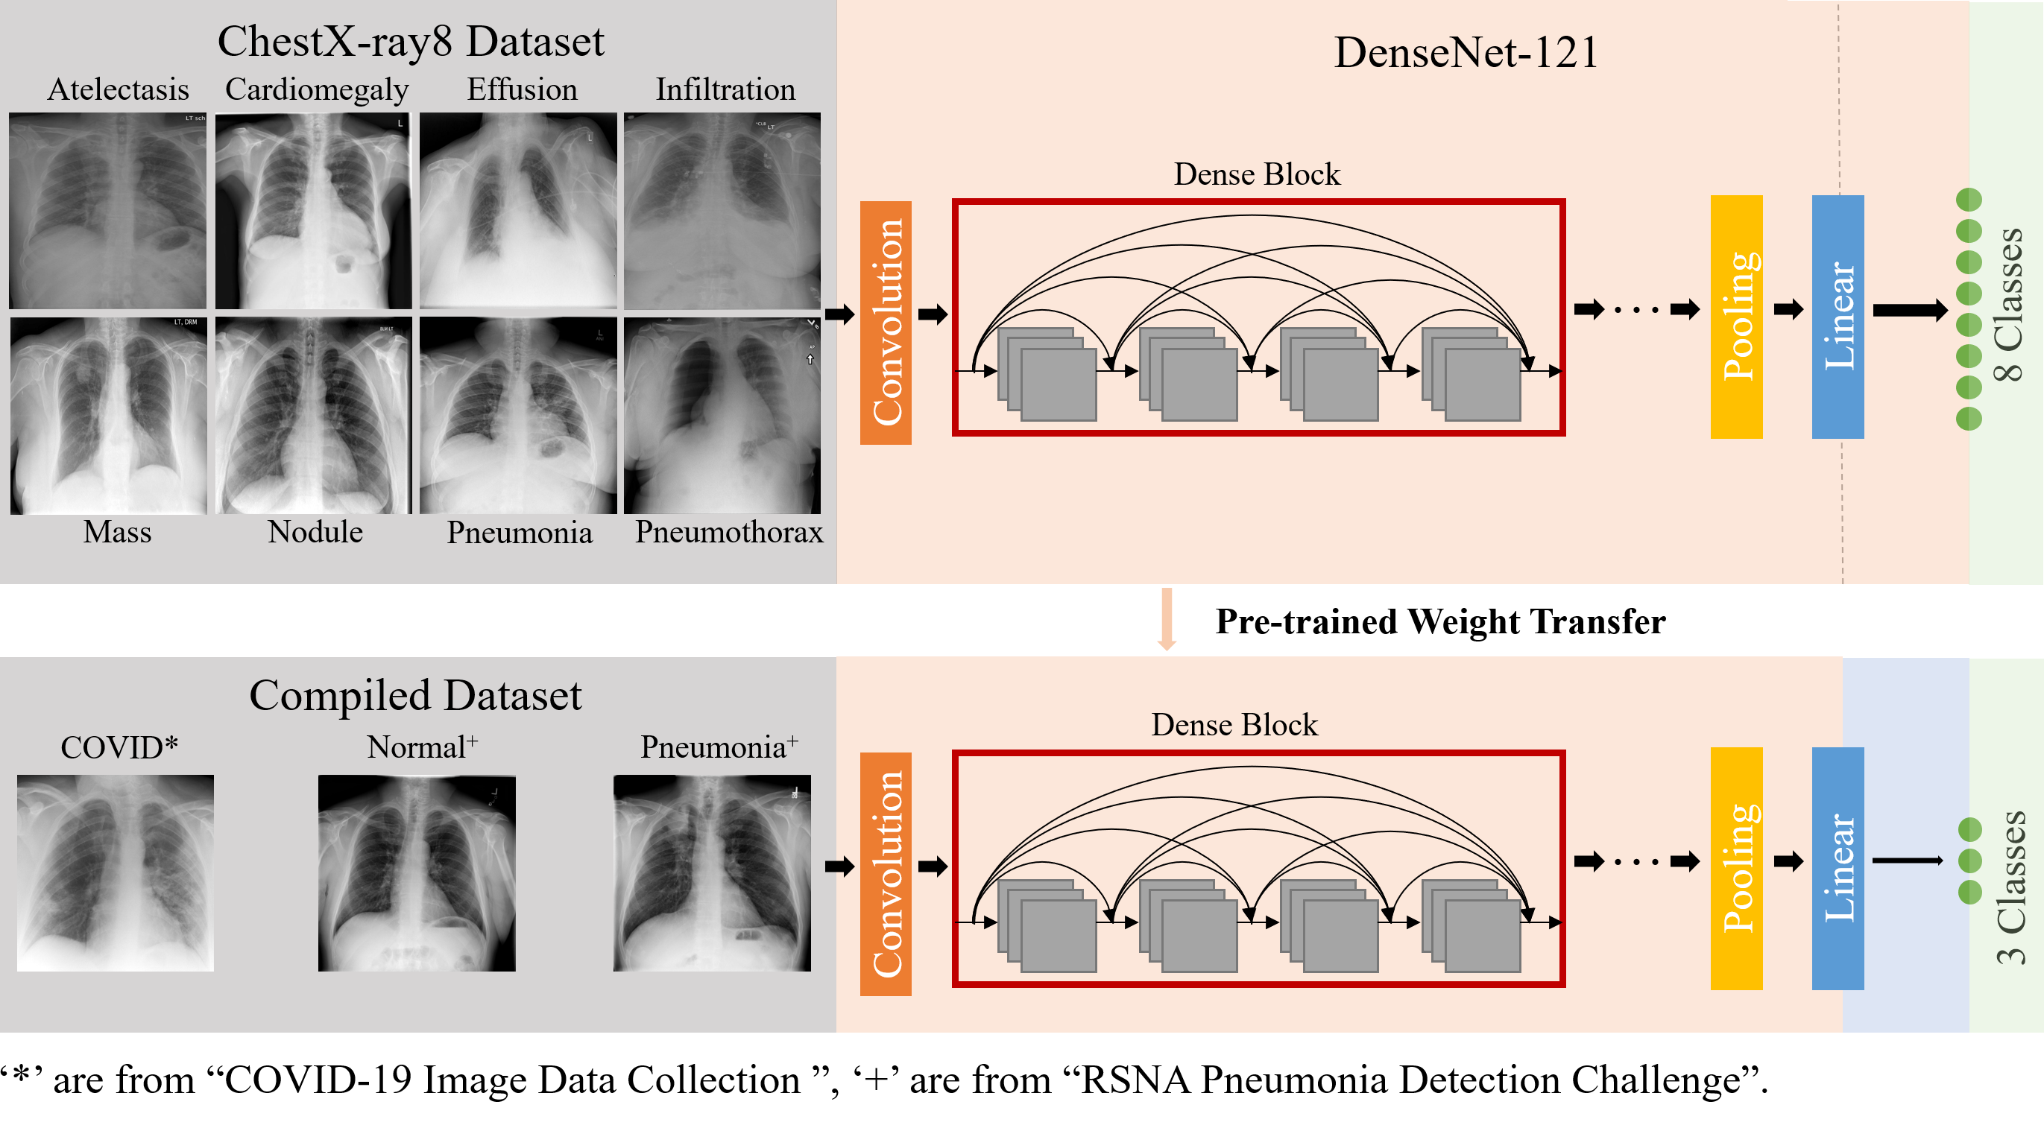
An Overview of COVID-Xpert Architecture

Slide 5
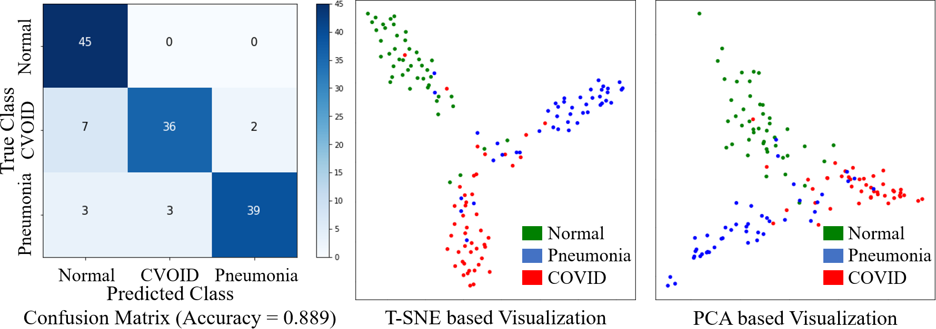
Visualization of 3 Classes of Chest X-Ray Images

Slide 6
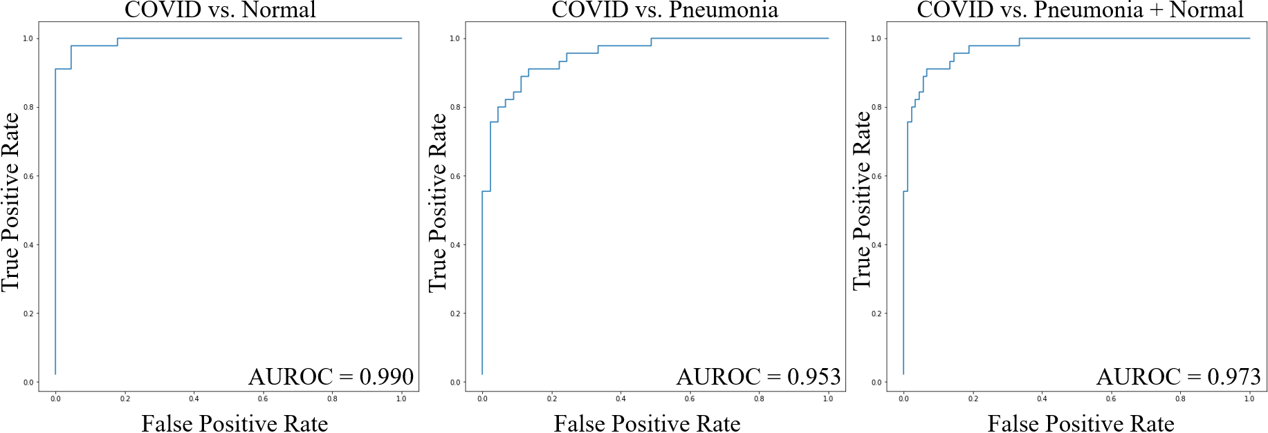
Discerning COVID with non-COVID Images

Slide 7
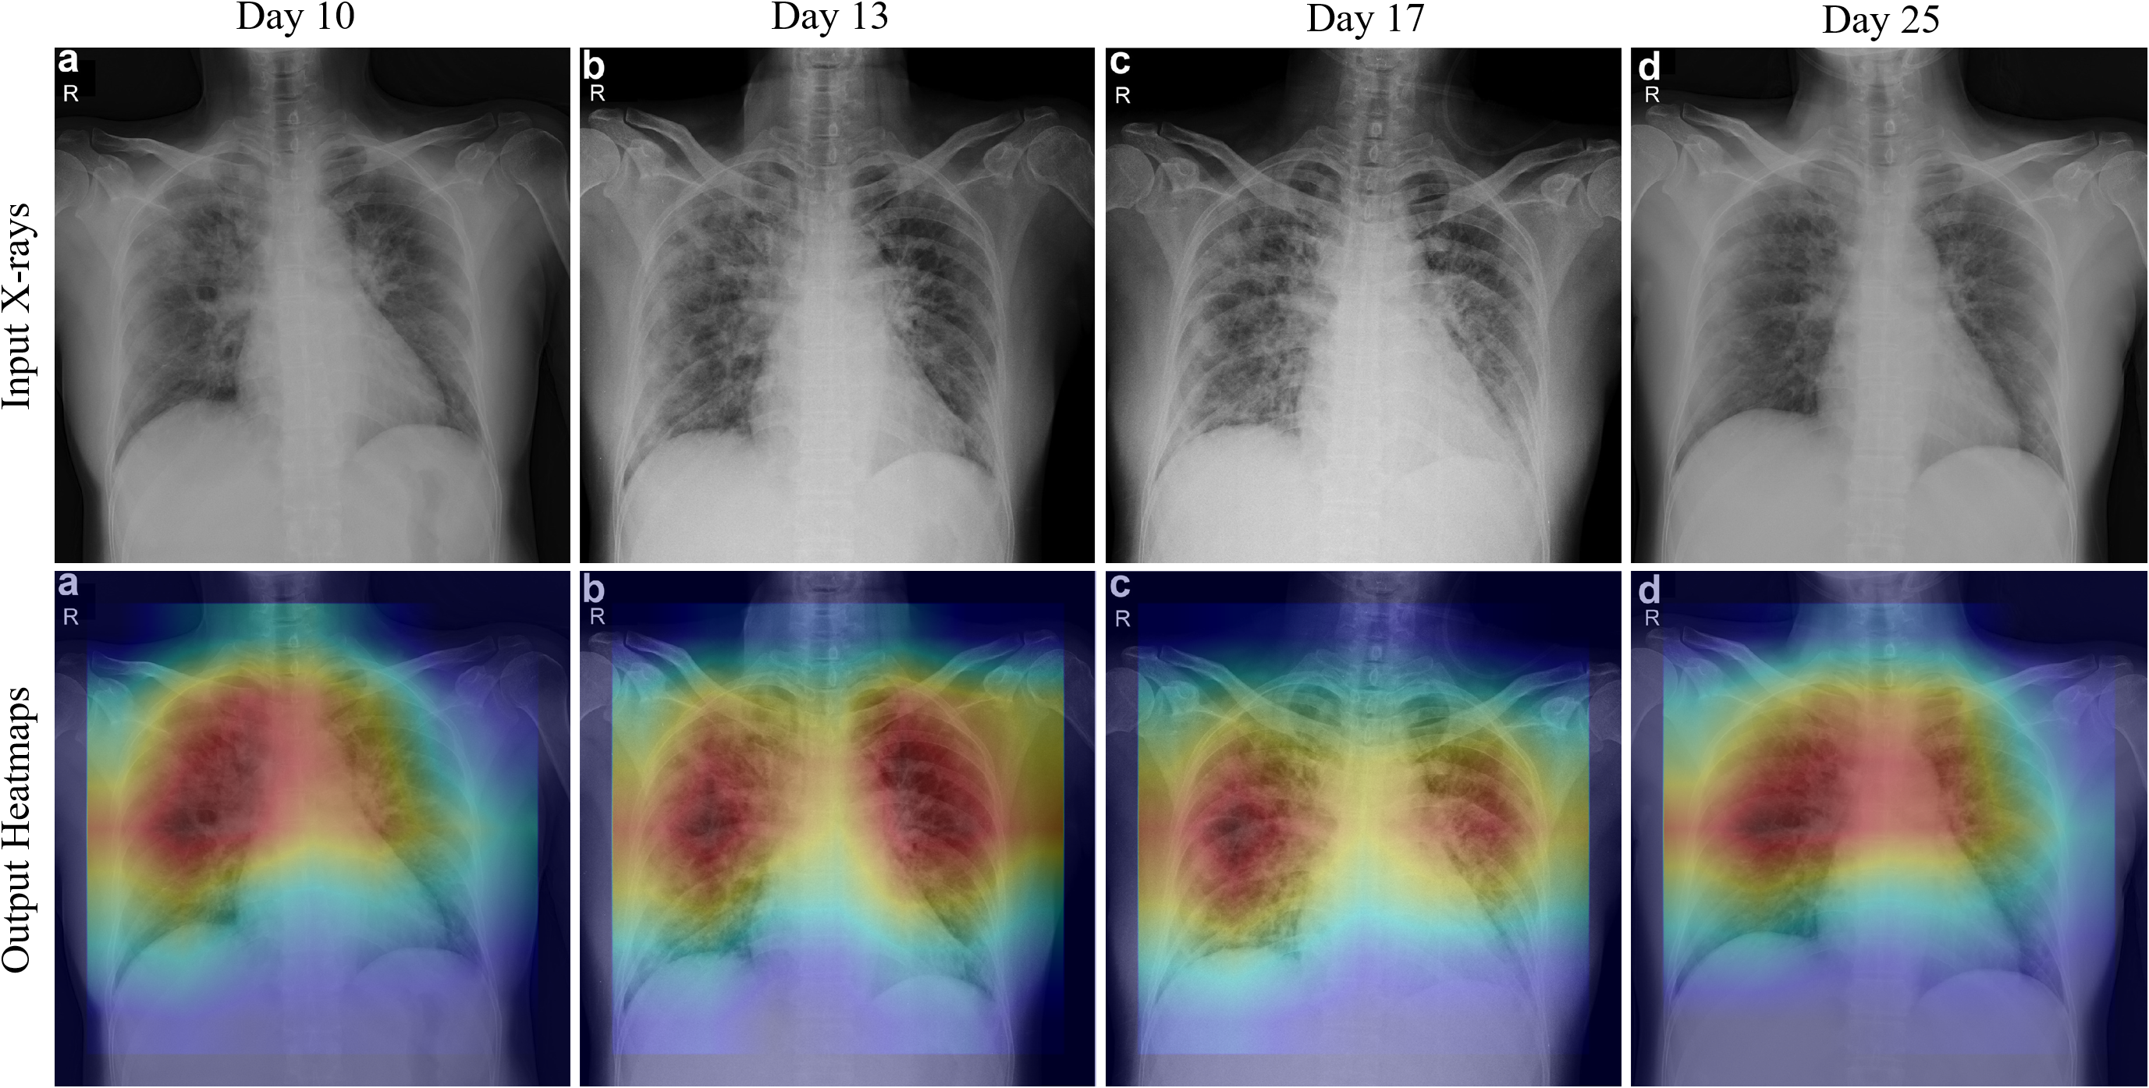
Longitudinal Observation of one Patient Layered with Explaining Heatmaps

Slide 8
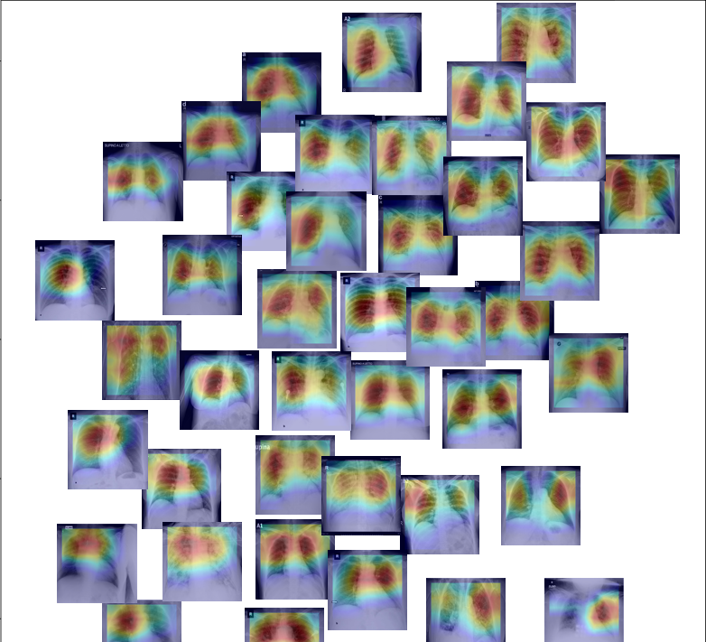
Spatially Distributed Thumbnails of COVID Images

Slide 9
Conclusion and Discussion
Rapid, accurate yet inexpensive population screening approach
Explaining the stratification of COVID cases via layered heatmaps
The AI screening approach is applicable to Ultrasound images
If you like our work, please cite it in your work! Thanks.
@misc{li2020covidxpert,
title={COVID-Xpert: An AI Powered Population Screening of COVID-19 Cases Using Chest Radiography Images},
author={Xin Li and Dongxiao Zhu},
year={2020},
eprint={2004.03042},
archivePrefix={arXiv},
primaryClass={eess.IV}
}

